Slide 1
Apr.27. 2026
Observing satellite proximity Operation
Designing Observer Satellite’s Optimal Trajectory by
Second-Order MDP with Dynamic Programming
Hongseok Kim
Graduate Research Assistant, The University of Texas at Austin

Slide 2
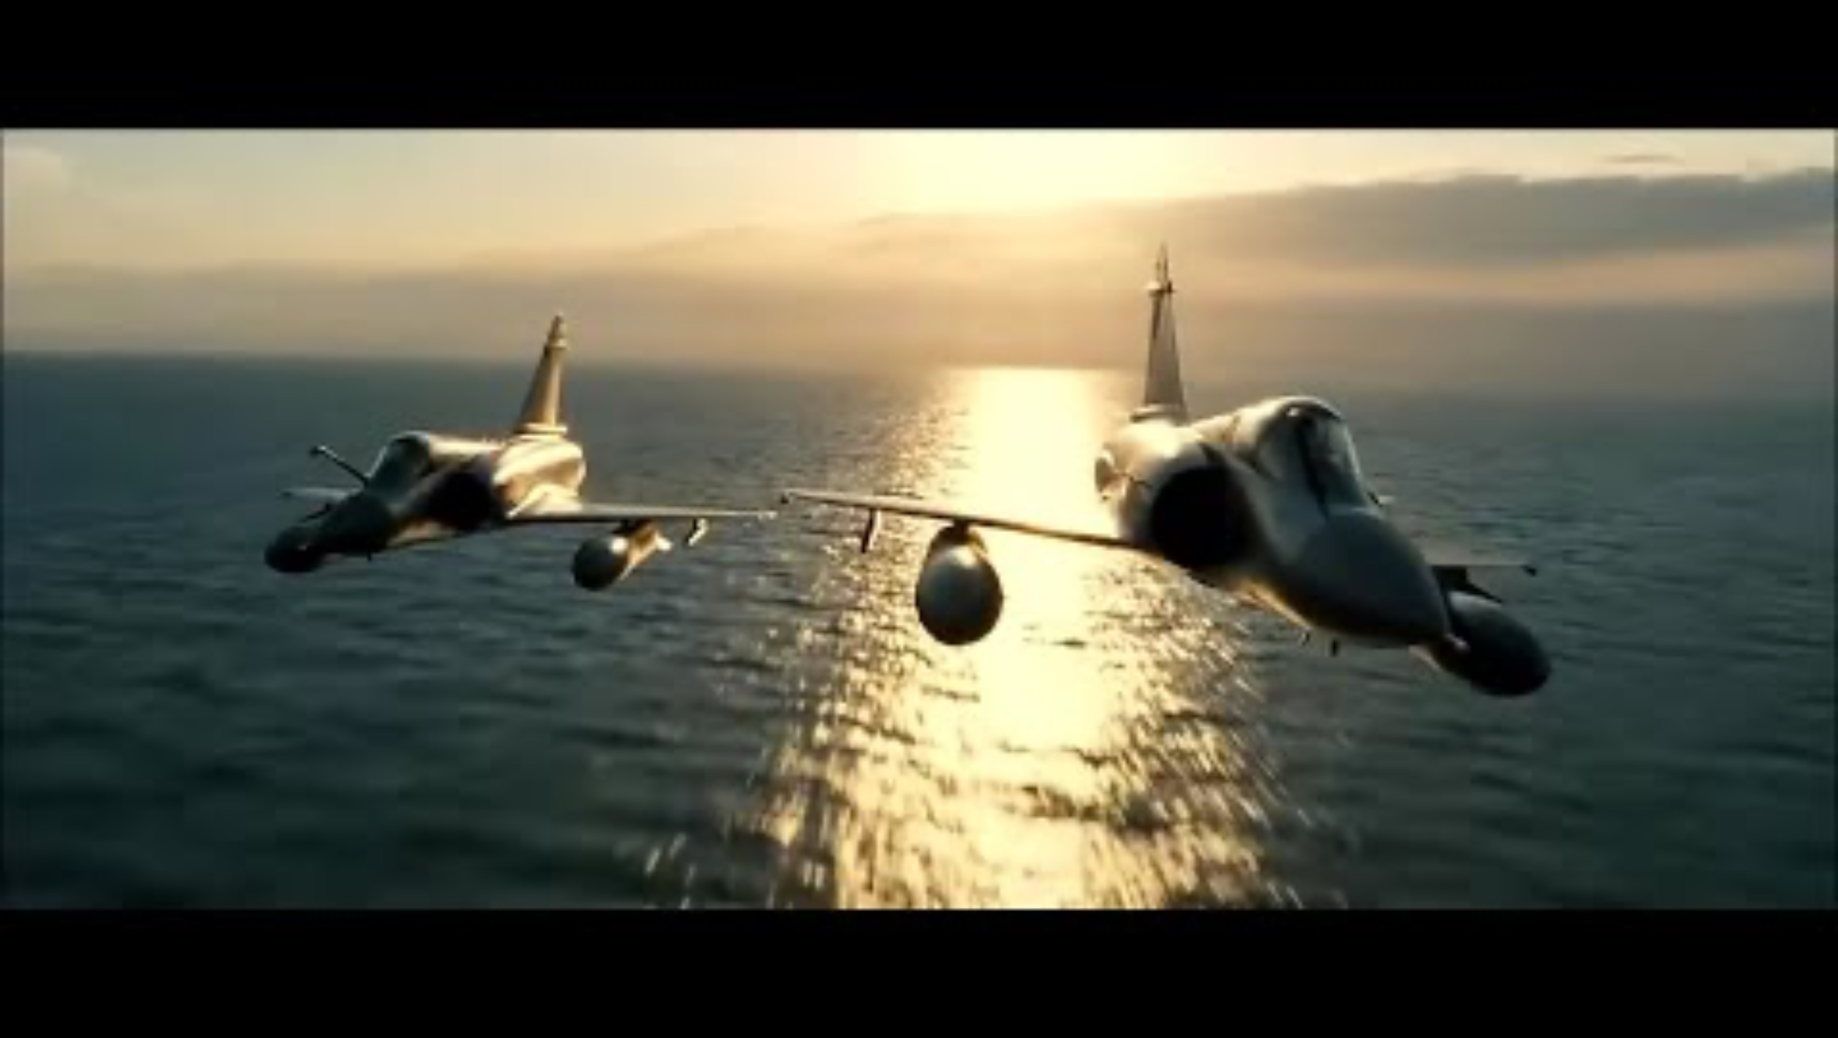

Slide 3

Les Chevaliers du ciel
Les Chevaliers du Ciel (Sky fighters) was filmed in co-operation with the French Air Force. Initially the standard safety rules applied, but eventually the minimum allowed altitude was reduced to 3 m (10 ft) and the minimum distance between aircraft was reduced to 1 m (3 ft).
The filming of these flight sequences were mainly done from the air by Eric Magnan. To achieve this, one of the Mirage's external fuel tanks was modified to fit multiple cameras.
A HD camera was considered for this purpose, but it did not fit in the fuel pod. Tracking shots were done from a hired Lear Jet.

Slide 4
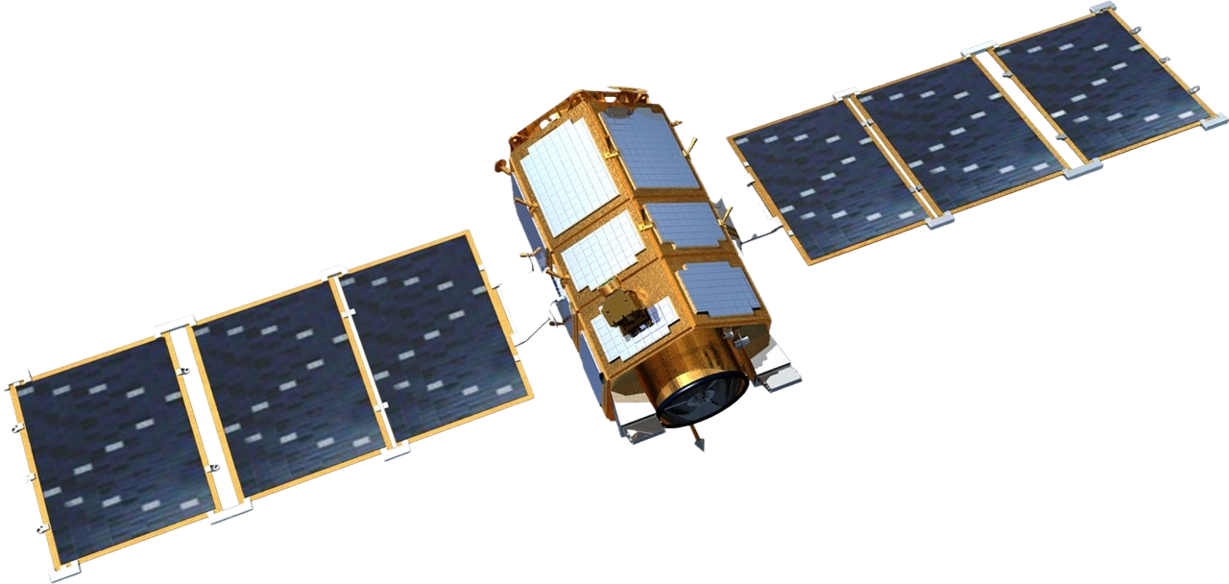
Problem Statement
Design Observer Satellite’s Trajectory to capture both chaser and target in single FOV
While minimizing delta-v for Observer Satellite
Target Satellite
Chaser Satellite
Observer Satellite

Slide 5
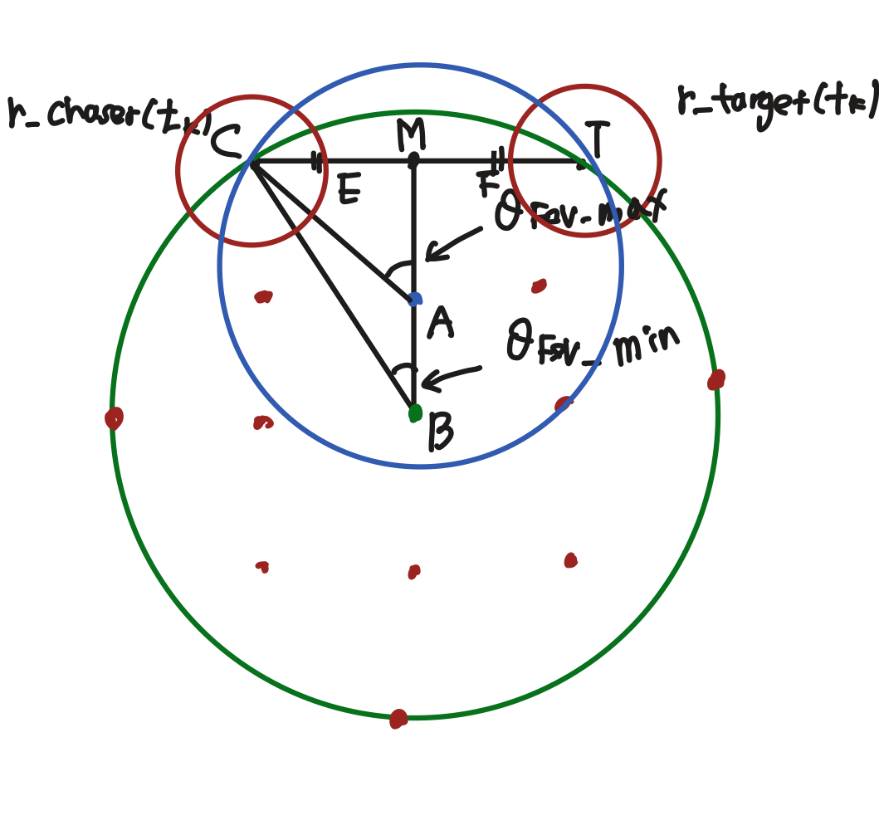
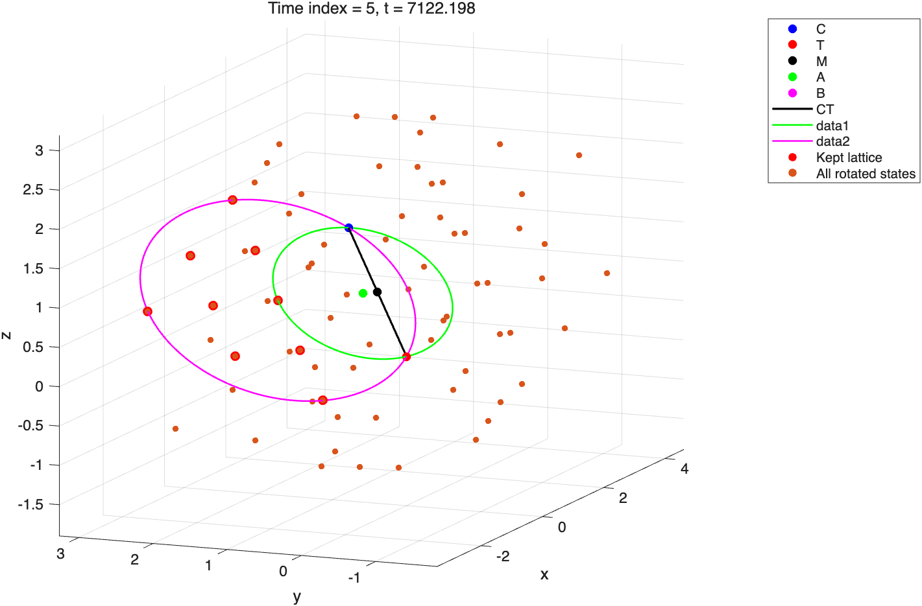
How to place observer satellite in given FOV condition?
We have to do Geometry
Red dot: available Points
When placing this in this lattice points, the Observer will capture caser and target in given FOV condition
Rotate lattice with respect to C,T will make donut space

Slide 6
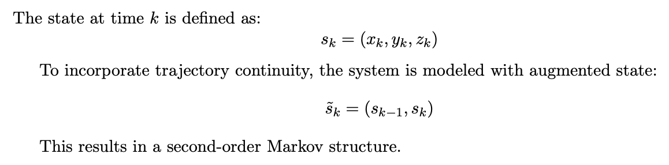
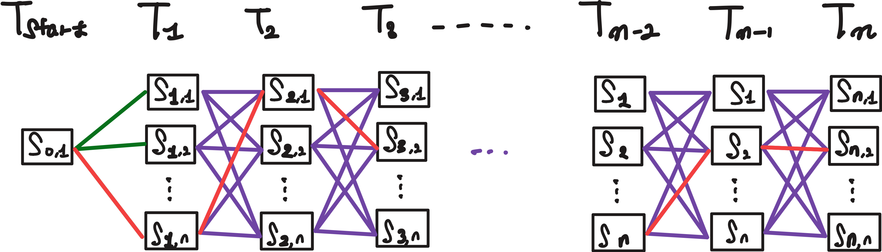
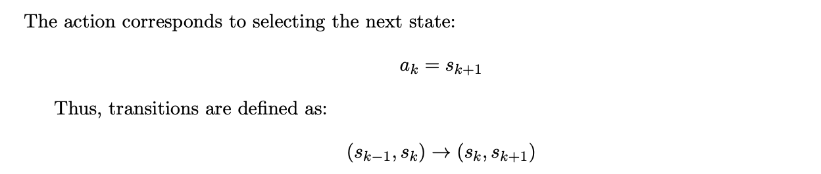
MDP Formulation
State Definition
Action Definition

Slide 7
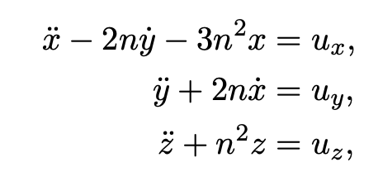




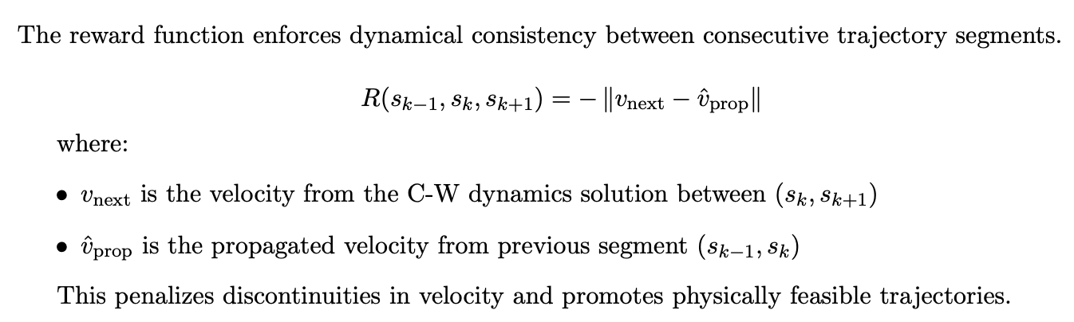
MDP Formulation
Deterministic State Transition vis C-W dynamics
Reward Function

Slide 8

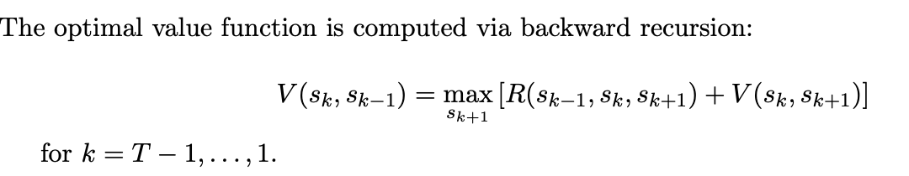
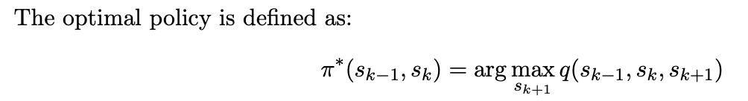
MDP Formulation
State Value function and Action Value Function
 | time | previous_state | current_state | optimal_next_state | delta_t | state_value
1 | 0 | 1 | 1 | 34 | 593.52 | NaN
2 | 593.52 | 1 | 34 | 34 | 593.52 | -0.092355
3 | 1187 | 34 | 34 | 1 | 593.52 | -0.070925
4 | 1780.5 | 34 | 1 | 38 | 593.52 | -0.052136
5 | 2374.1 | 1 | 38 | 39 | 593.52 | -0.039773
6 | 2967.6 | 38 | 39 | 14 | 593.52 | -0.038613
7 | 3561.1 | 39 | 14 | 44 | 593.52 | -0.031591
8 | 4154.6 | 14 | 44 | 38 | 593.52 | -0.019682
9 | 4748.1 | 44 | 38 | 10 | 593.52 | -0.01564
10 | 5341.6 | 38 | 10 | 2 | 593.52 | -0.01085
11 | 5935.2 | 10 | 2 | 66 | 593.52 | -0.0099955
12 | 6528.7 | 2 | 66 | 53 | 593.52 | -0.0047658
13 | 7122.2 | 66 | 53 | 19 | 593.52 | -0.0021582
14 | 7715.7 | 53 | 19 | 12 | 593.52 | -0.0014469
Backward Dynamic Programming for getting optimal policy

Slide 9
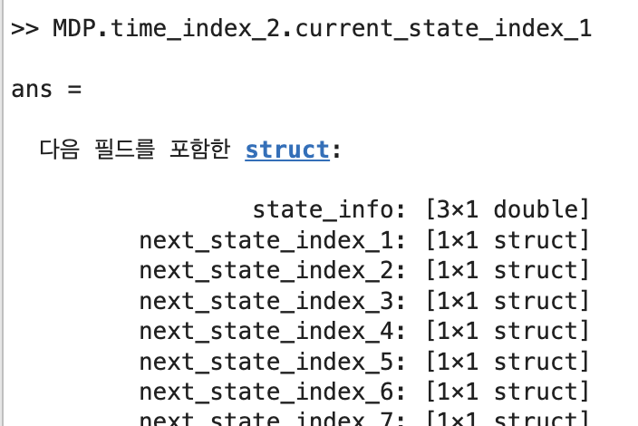
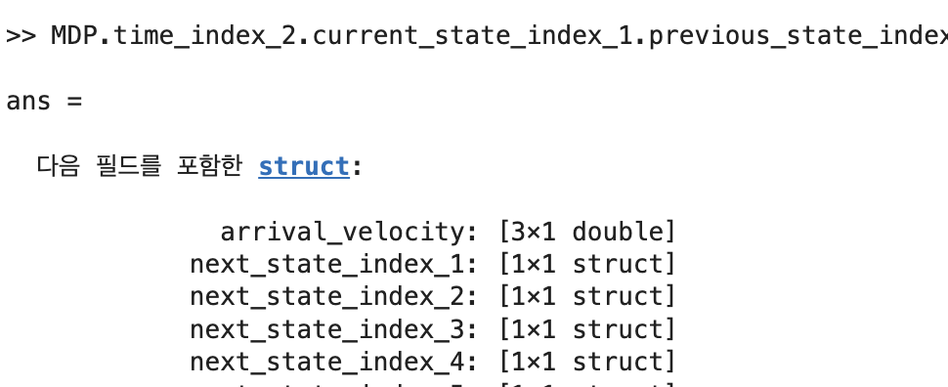
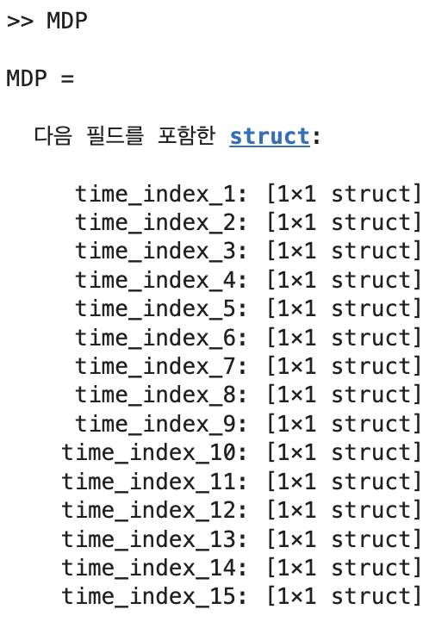
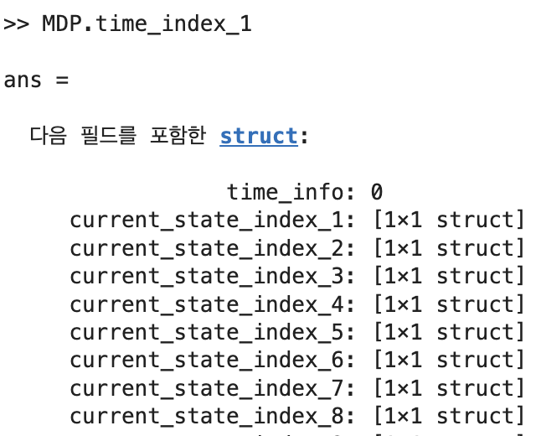
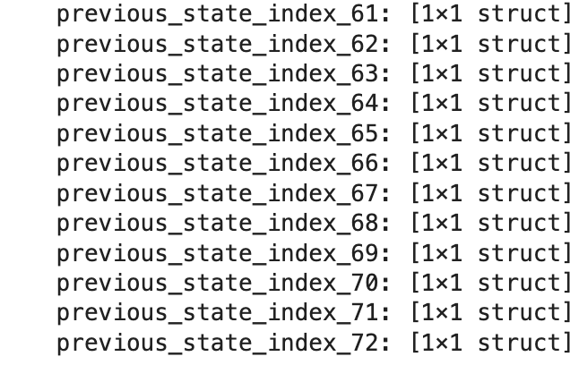
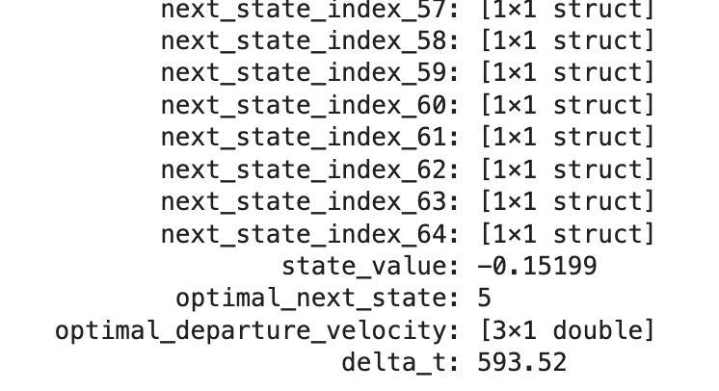
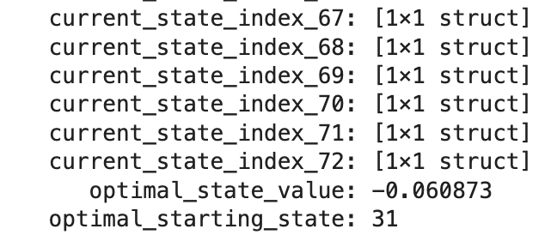
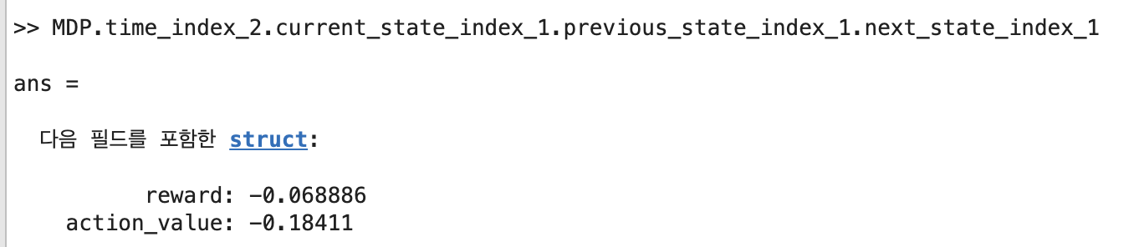
MDP Structure

Slide 10
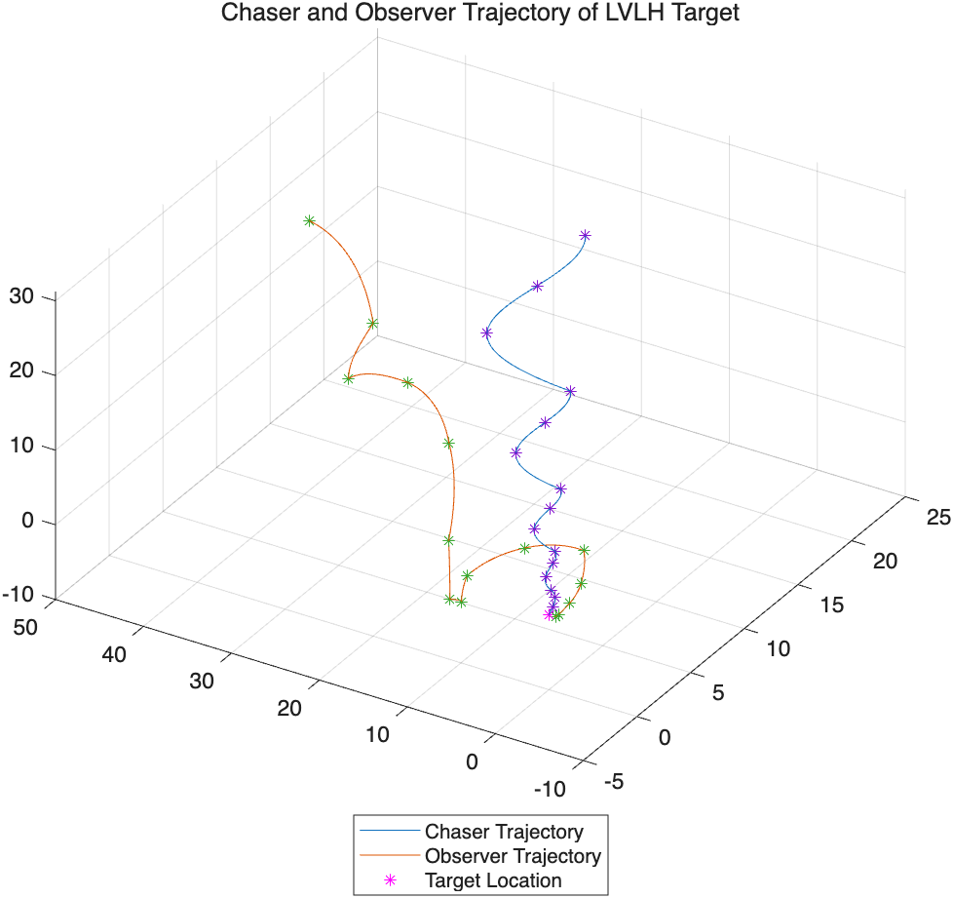
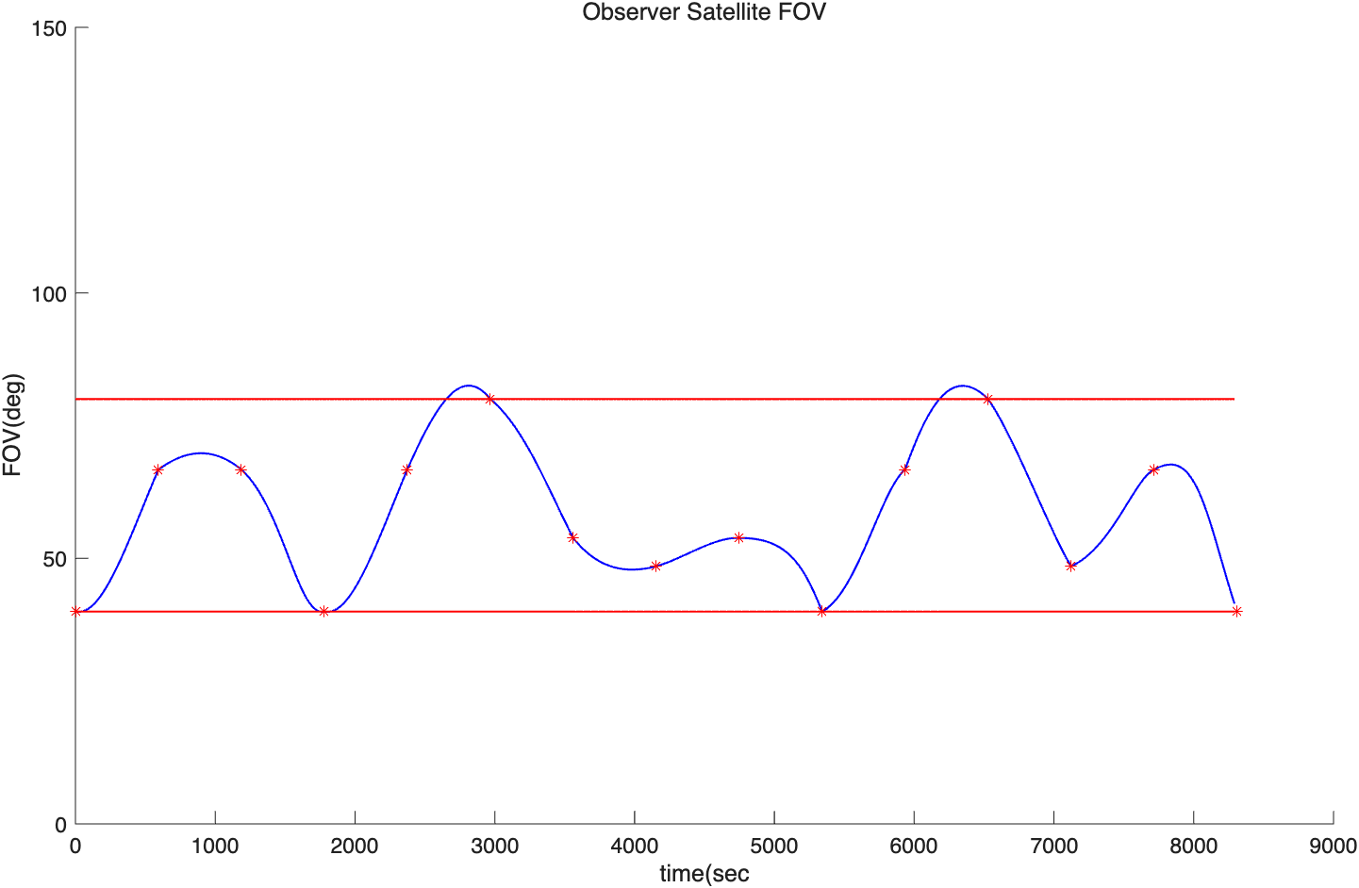
RPOD Case - GlideSlope
 | time | state_value
1 | 0 | NaN
2 | 593.52 | -0.092355
3 | 1187 | -0.070925
4 | 1780.5 | -0.052136
5 | 2374.1 | -0.039773
6 | 2967.6 | -0.038613
7 | 3561.1 | -0.031591
8 | 4154.6 | -0.019682
9 | 4748.1 | -0.01564
10 | 5341.6 | -0.01085
11 | 5935.2 | -0.0099955
12 | 6528.7 | -0.0047658
13 | 7122.2 | -0.0021582
14 | 7715.7 | -0.0014469

Slide 11
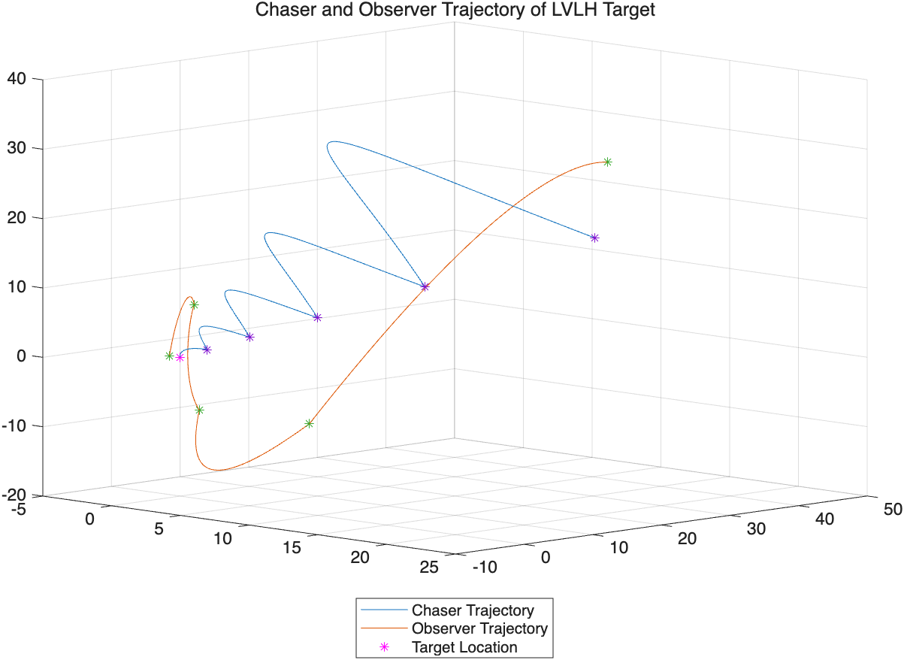
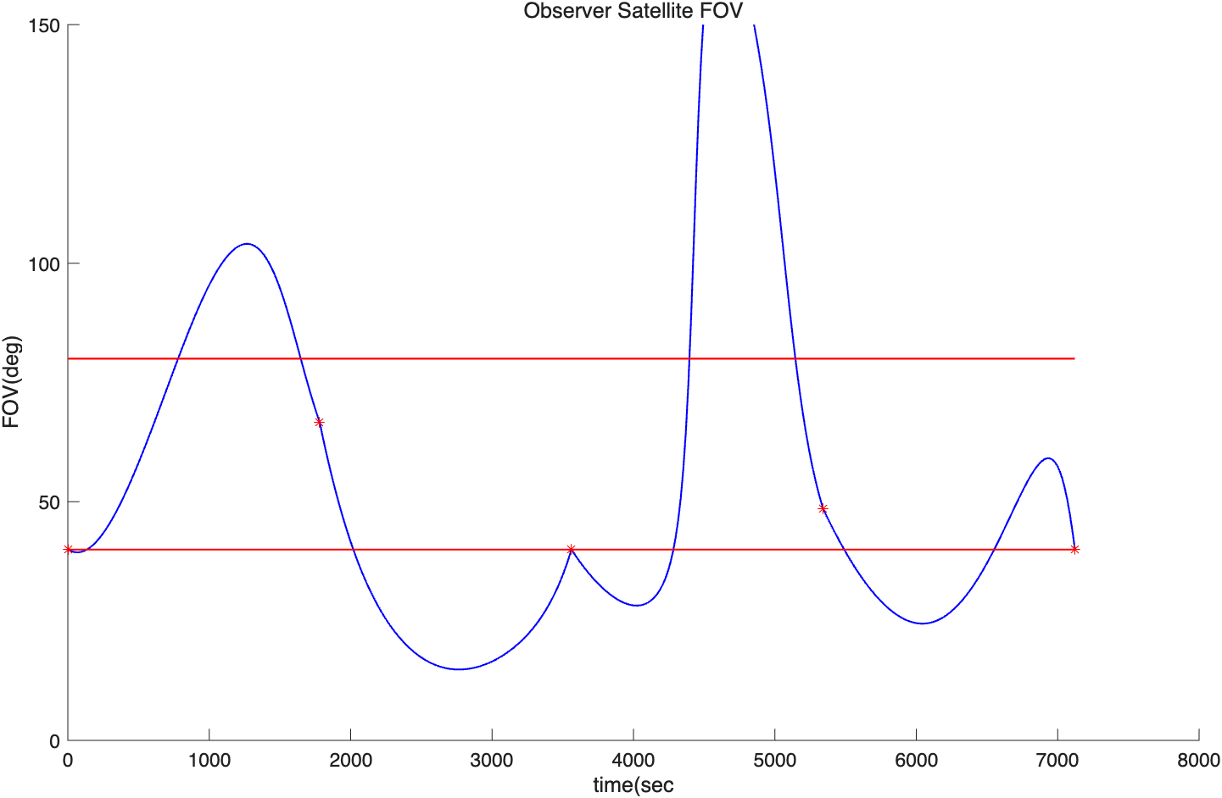
RPOD Case – Glideslope
5 Impulse
 | state_value
1 | NaN
2 | -0.025122
3 | -0.012172
4 | -0.001136

Slide 12
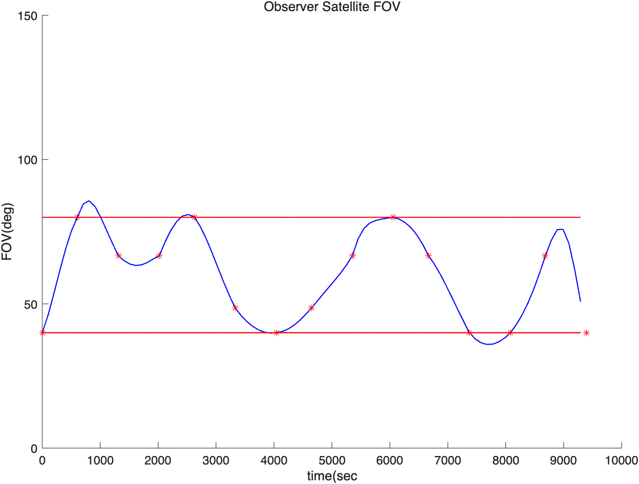
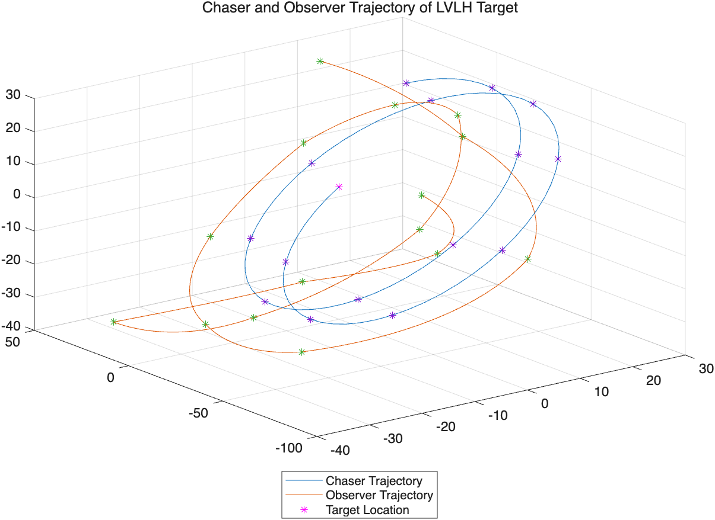
RPOD Case: Two Impulse
14 Impulse
 | state_value
1 | NaN
2 | -0.26887
3 | -0.24973
4 | -0.23417
5 | -0.18481
6 | -0.17643
7 | -0.1657
8 | -0.15519
9 | -0.15032
10 | -0.12488
11 | -0.10994
12 | -0.093588
13 | -0.018272
14 | -0.0078142

Slide 13
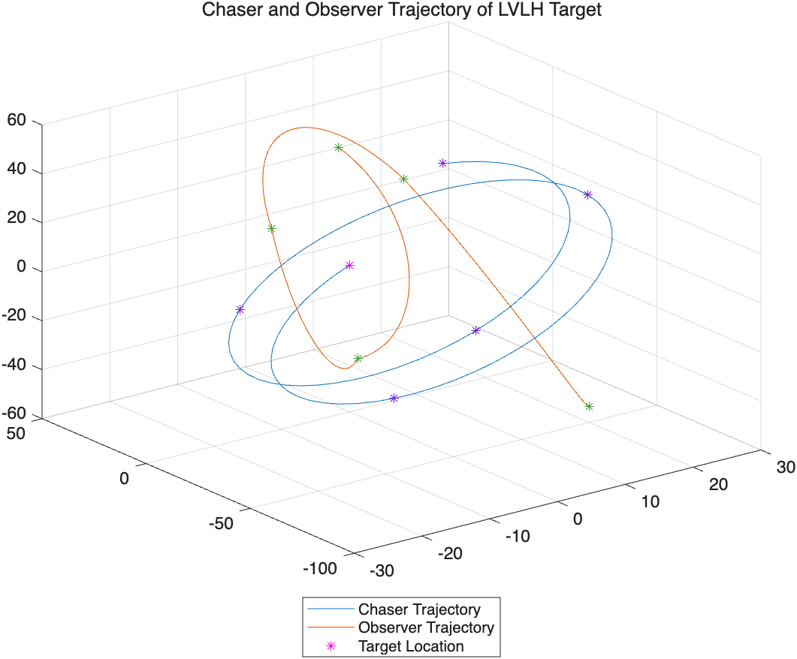
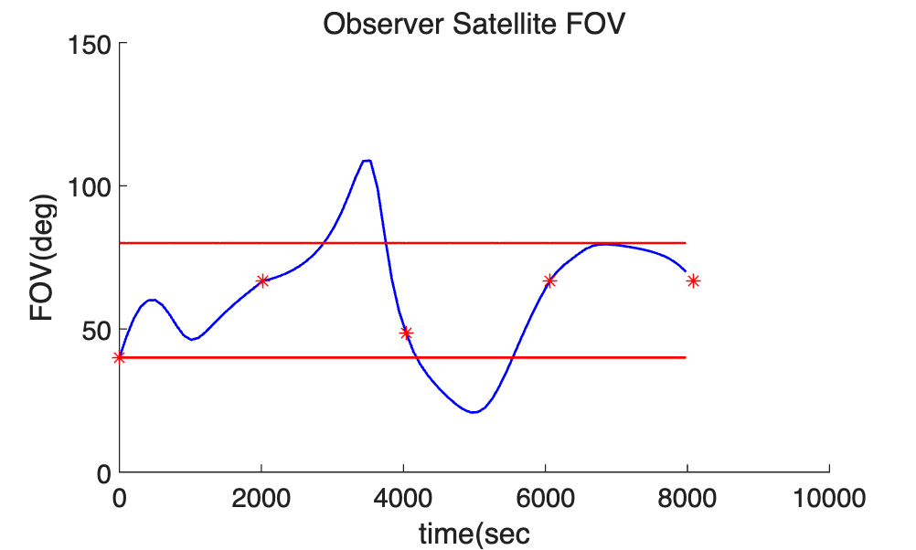
RPOD Case: Two Impulse
5 Impulse
 | state_value
1 | NaN
2 | -0.037278
3 | -0.017254
4 | -0.009449

Slide 14
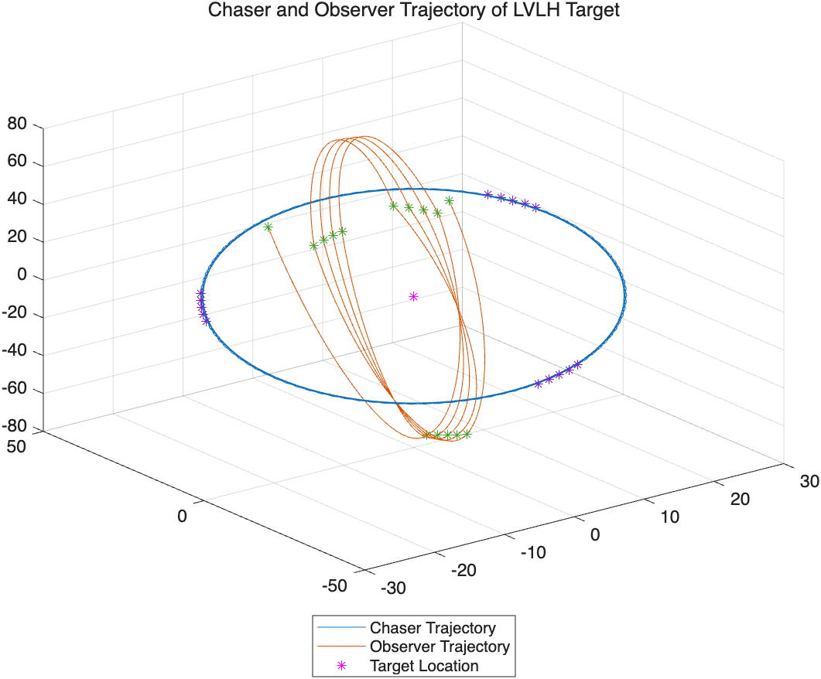
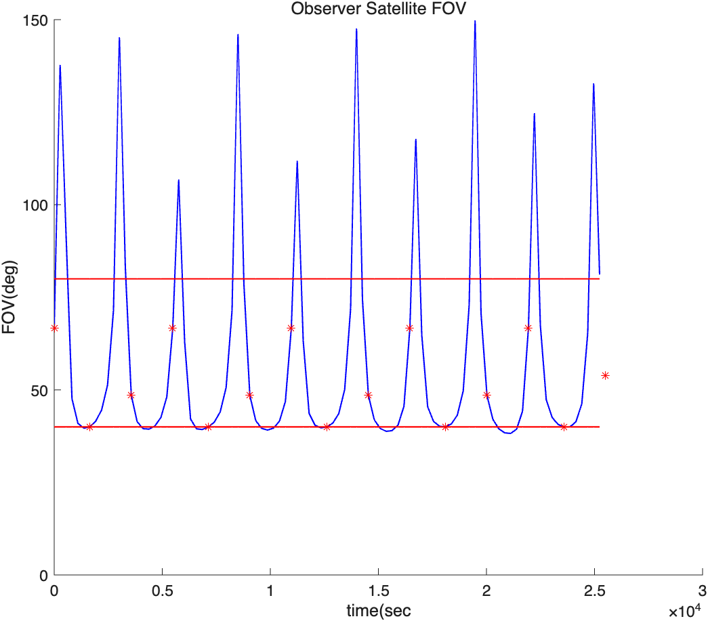
RPOD Case: CircumNav
 | state_value
1 | NaN
2 | -0.061683
3 | -0.05887
4 | -0.054917
5 | -0.046754
6 | -0.040485
7 | -0.037006
8 | -0.032447
9 | -0.027418
10 | -0.023309
11 | -0.019716
12 | -0.015506
13 | -0.010085
14 | -0.0038141

Slide 15


